Slide 1
Final Review 2
University of British Columbia
CPSC 314 Computer Graphics
Jan-Apr 2016
Tamara Munzner
http://www.ugrad.cs.ubc.ca/~cs314/Vjan2016

Slide 2
Viewing, Continued

Slide 3
Review: From VCS to NDCS
perspective view volume
orthographic view volume
y=top
y=top
x=left
x=left
y
y
z
x=right
VCS
VCS
y=bottom
z=-near
z=-far
x
z=-far
x
y=bottom
x=right
z=-near
orthographic camera
  center of projection at infinity
  no perspective convergence
NDCS
y
(1,1,1)
z
(-1,-1,-1)
x

Slide 4
Review: Orthographic Derivation
scale, translate, reflect for new coord sys
VCS
NDCS
y=top
y
(1,1,1)
x=left
y
z
z
(-1,-1,-1)
x=right
x
x
z=-far
y=bottom
z=-near

Slide 5
Review: Orthographic Derivation
scale, translate, reflect for new coord sys

Slide 6
Review: Projection Normalization
warp perspective view volume to orthogonal view volume
    render all scenes with orthographic projection!
    aka perspective warp
x
x
z=α
z=d
z=0
z=d

Slide 7
Review: Separate Warp From Homogenization
viewing
clipping
normalized
device
VCS
V2C
CCS
C2N
NDCS
projection
transformation
perspective
division
alter w
/ w
warp requires only standard matrix multiply
  distort such that orthographic projection of distorted objects is desired persp projection
    w is changed
  clip after warp, before divide
  division by w: homogenization

Slide 8
Review: Perspective Derivation
shear
  change x/y if asymmetric r/l, t/b
scale
projection-normalization
  pre-warp according to z
VCS
y=top
NDCS
z
x=left
y
(1,1,1)
y
z
(-1,-1,-1)
x
y=bottom
z=-near
z=-far
x
x=right

Slide 9
Review: N2D Transformation
Display z range is 0 to 1.
glDepthRange(n,f) can constrain further, but depth = 1 is both max and default
reminder:
NDC z range is -1 to 1
0
x
500
y
0
y
height
1
x
viewport
NDC
-1
width
-1
1
300

Slide 10
Review: Projective Rendering Pipeline
following pipeline from top/left to bottom/right: moving object POV
scene.add(x)
object
world
viewing
THREE.PerspectiveCamera(...)
alter w
O2W
WCS
W2V
VCS
V2C
OCS
modeling
transformation
viewing
transformation
projection
transformation
clipping
m.makeTranlation(x,y,z)
m.makeRotation(a,x,y,z)
x.setMatrix(m)
camera.lookAt(...)
C2N
/ w
CCS
perspective
division
normalized
device
  OCS - object coordinate system
  WCS - world coordinate system
  VCS - viewing coordinate system
  CCS - clipping coordinate system
  NDCS - normalized device coordinate system
  DCS - device coordinate system
canvas.{w,h}
gl.viewport(x,y,a,b)
N2D
NDCS
viewport
transformation
device
DCS

Slide 11
Review: WebGL Example
go back from end of pipeline to beginning: coord frame POV!
object
world
viewing
clipping
O2W
W2V
VCS
V2C
CCS
OCS
WCS
modeling
transformation
viewing
transformation
projection
transformation
CCS
gl.viewport(0,0,w,h);
THREE.PerspectiveCamera(view angle, aspect, near, far)
u_xformMatrix = Identity()
gl.uniformMatrix4fv(u_xformMatrix, false, xformMatrix);
torsoGeometry.applyMatrix(u_xformMatrix );
var torso = new THREE.Mesh(torsoGeometry,normalMaterial);
scene.add(torso);
VCS
WCS
OCS1

Slide 12
Review: Coord Sys: Frame vs Point
read down: transforming between coordinate frames, from frame A to frame B
read up: transforming points, up from frame B coords to frame A coords
GL command order
DCS
display
D2N
gl.viewport(x,y,a,b)
N2D
NDCS
normalized device
N2V
THREE.PerspectiveCamera(...)
V2N
VCS
viewing
V2W
camera.lookAt(...)
W2V
WCS
world
W2O
m.makeRotationX(…)
O2W
OCS
object
scene.add(object)
pipeline interpretation

Slide 13
Post-Midterm Material

Slide 14
OPENGL RENDERING PIPELINE
Scene
Vertices and attributes
Camera Coords
Device Coords
Vertex Shader
Vertex Post-Processing
Rasterization
Fragment Shader
Per-Sample Operations
Framebuffer
Image

Slide 15
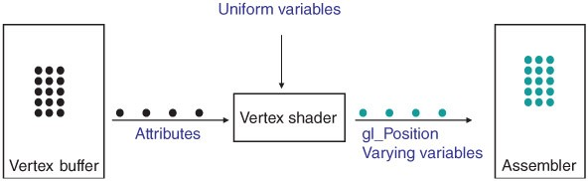
VERTEX SHADER

Slide 16
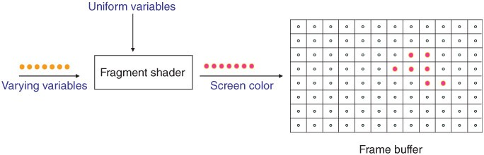
FRAGMENT SHADER

Slide 17
OPENGL RENDERING PIPELINE
Vertices
Vertex Shader
Vertex Post-Processing
and attributes
Modelview transform
Viewport transform
Per-vertex attributes
Clipping
Rasterization
Fragment Shader
Scan conversion
Texturing/...
Interpolation
Lighting/shading
Per-Sample Operations
Framebuffer
Depth test
Blending

Slide 18
Clipping/Rasterization/Interpolation

Slide 19
Review: Clipping
analytically calculating the portions of primitives within the viewport

Slide 20
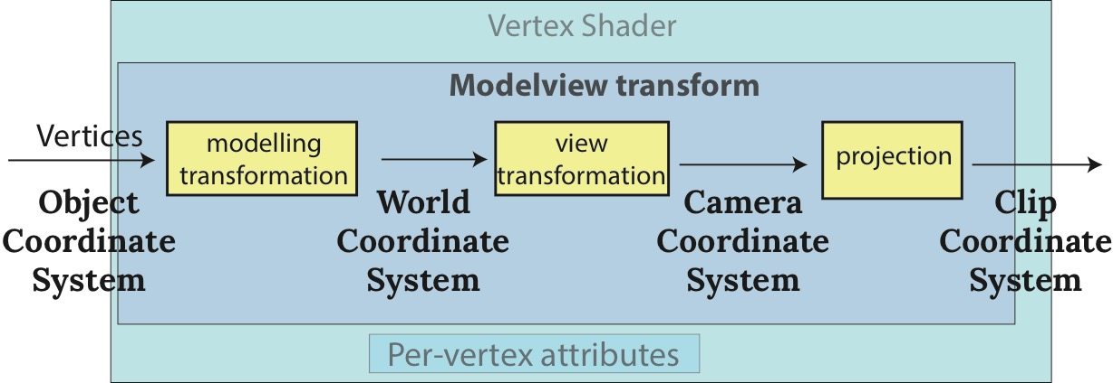
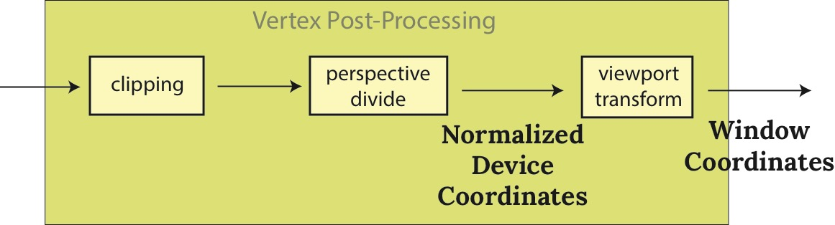
Review: Clipping
Perform clipping in clip-coordinates!
  After projection and before dividing by w

Slide 21
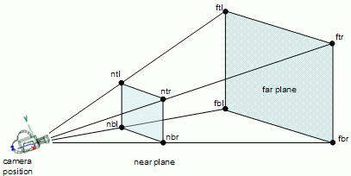
Review: Clipping coordinates
Eye coordinates (projected) → clip coordinates → normalized device coordinates (NDCs)
Dividing clip coordinates
by the component (the fourth component in the homogeneous coordinates) yields normalized device coordinates (NDCs).

Slide 22
Review: Scan Conversion
convert continuous rendering primitives into discrete fragments/pixels
  given vertices in DCS, fill in the pixels
display coordinates required to provide scale for discretization

Slide 23
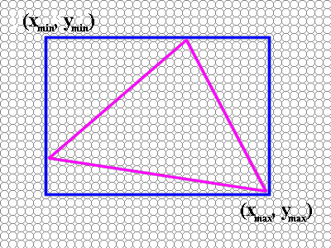
Review: Scanline Idea
scanline: a line of pixels in an image
basic structure of code:
  Setup: compute edge equations, bounding box
  (Outer loop) For each scanline in bounding box...
  (Inner loop) …check each pixel on scanline, evaluating edge equations and drawing the pixel if all three are positive
3
1
5=0
2
P
4

Slide 24
Review: Bilinear Interpolation
interpolate quantity along L and R edges,
as a function of y
    then interpolate quantity as a function of x
P₁
P₃
P(x,y)
P_{L}
P_{R}
y
P₂

Slide 25
Review: Bilinear interpolation
P₁
P₃
P_{L}
P
P_{R}
b₁ : b₂
c₁: c₂
d₂ : d₁
P₂

Slide 26
Review: Barycentric Coordinates
weighted (affine) combination of vertices
(1,0,0)
(0,0,1)
(0,1,0)

Slide 27
Review: Computing Barycentric Coordinates
2D triangle area
  half of parallelogram area
    from cross product
  A = Α_{P1} +Α_{P2} +Α_{P3}
  α = Α_{P1} /A
  β = Α_{P2} /A
  γ = Α_{P3} /A
(α,β,γ) =
(1,0,0)
(α,β,γ) =
(0,0,1)
(α,β,γ) =
(0,1,0)
weighted combination of three points

Slide 28
Lighting/Shading

Slide 29
Review: Reflectance
specular: perfect mirror with no scattering
gloss: mixed, partial specularity
diffuse: all directions with equal energy
  + + =
specular + glossy + diffuse =
reflectance distribution

Slide 30

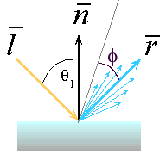
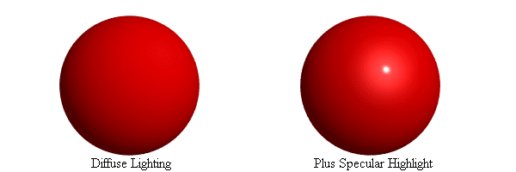
Review: Reflection Equations
l
n
I_{diffuse} = k_{d} I_{light} (n • l)
θ
v
  R = 2 ( N (N · L)) – L
h
n
v
l
reminder: normalize all vectors: n,l,r,v,h

Slide 31
Review: Reflection Equations
full Phong lighting model
  combine ambient, diffuse, specular components
Blinn-Phong lighting
  don’t forget to normalize all lighting vectors!! n,l,r,v,h

Slide 32
Review: Lighting
lighting models
  ambient
    normals don’t matter
  Lambert/diffuse
    angle between surface normal and light
  Phong/specular
    surface normal, light, and viewpoint
light and material interaction
  component-wise multiply
    (l_{r},l_{g},l_{b}) x (m_{r},m_{g},m_{b}) = (l_{r}*m_{r}, l_{g}*m_{g}, l_{b}*m_{b})

Slide 33
Review: Light Sources
directional/parallel lights
    point at infinity: (x,y,z,0)^{T}
point lights
    finite position: (x,y,z,1)^{T}
spotlights
    position, direction, angle
ambient lights

Slide 34
Review: Light Source Placement
geometry: positions and directions
  standard: world coordinate system
    effect: lights fixed wrt world geometry
  alternative: camera coordinate system
    effect: lights attached to camera (car headlights)

Slide 35
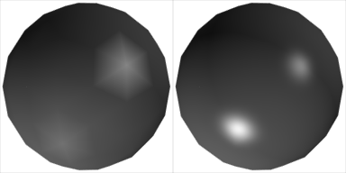
Review: Shading Models
flat shading
  for each polygon
    compute Phong lighting just once
Gouraud shading
  compute Phong lighting at the vertices
  for each pixel in polygon, interpolate colors
Phong shading
  for each pixel in polygon
    interpolate normal
    compute Phong lighting

Slide 36
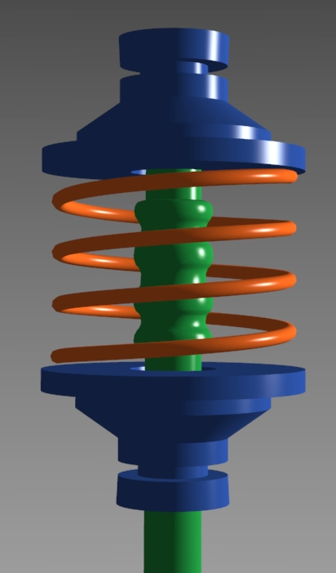
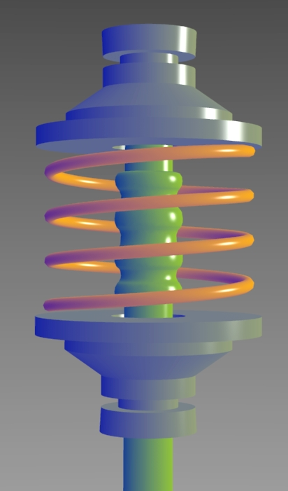
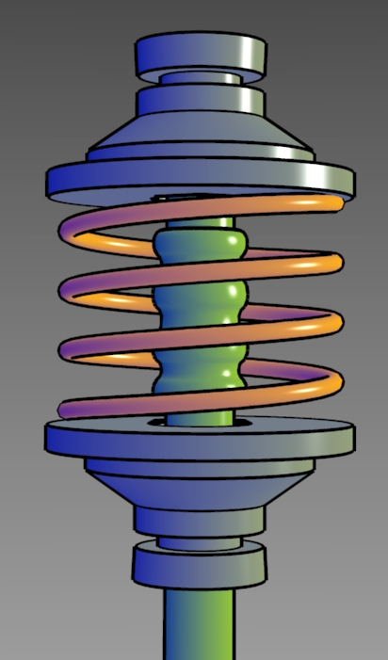
Review: Non-Photorealistic Shading
cool-to-warm shading:
draw silhouettes: if ,e=edge-eye vector
draw creases: if
standard
cool-to-warm
with edges/creases
http://www.cs.utah.edu/~gooch/SIG98/paper/drawing.html

Slide 37
Texturing

Slide 38
Review: Texture Coordinates
texture image: 2D array of color values (texels)
assigning texture coordinates (u,v) at vertex with object coordinates (x,y,z,w)
  sometimes called (s,t) instead of (u,v)
  use interpolated (u,v) for texel lookup at each pixel
  use value to modify a polygon color or other property
  specified by programmer or artist

Slide 39
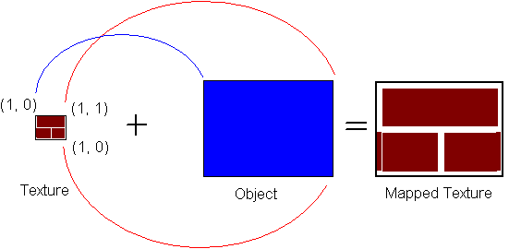
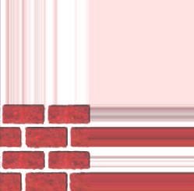
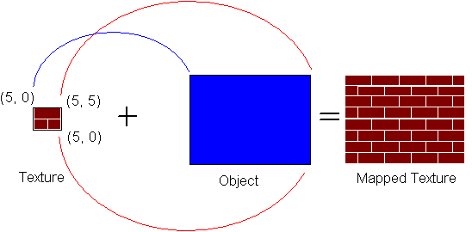
Review: Tiled Texture Map
(1,0)
(1,1)
clamp vs repeat
(0,0)
(0,1)
(4,0)
(4,4)
(0,0)
(0,4)

Slide 40

Review: Fractional Texture Coordinates
texture
image
(0,1)
(1,1)
(0,.5)
(.25,.5)
(0,0)
(1,0)
(0,0)
(.25,0)

Slide 41
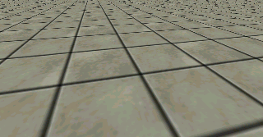

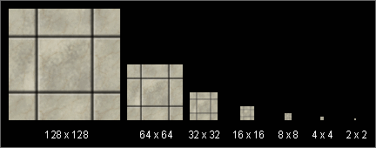
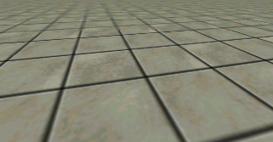
Review: MIPmapping
image pyramid, precompute averaged versions
  avoid aliasing artifacts
  only requires 1/3 more storage
Without MIP-mapping
With MIP-mapping

Slide 42
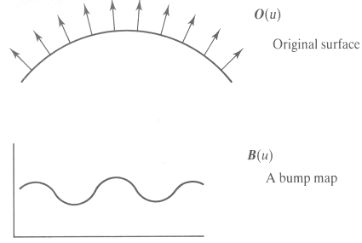
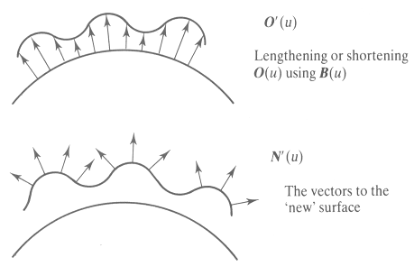
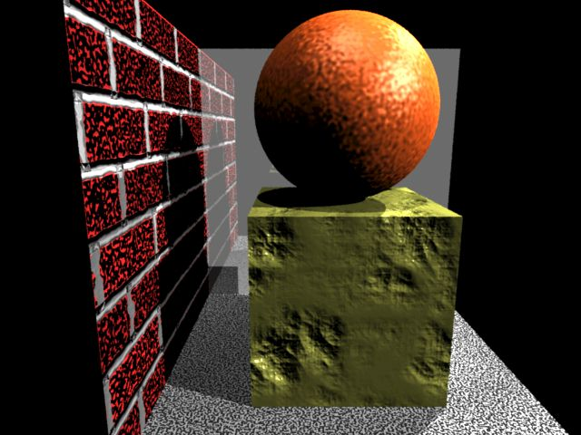
Review: Bump Mapping: Normals As Texture
create illusion of complex geometry model
control shape effect by locally perturbing surface normal

Slide 43
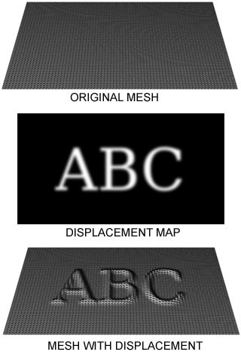
Review: Displacement Mapping
bump mapping gets silhouettes wrong
  shadows wrong too
change surface geometry instead
  only recently available with realtime graphics
  need to subdivide surface
https://en.wikipedia.org /wiki/Displacement_map ping#/media/File:Displacement.jpg

Slide 44
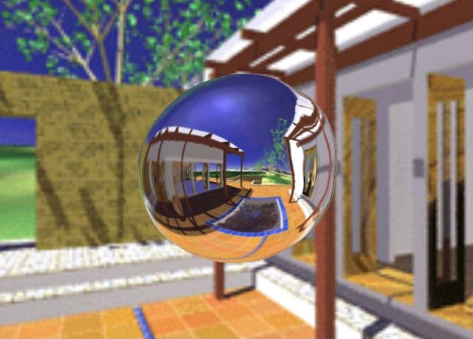
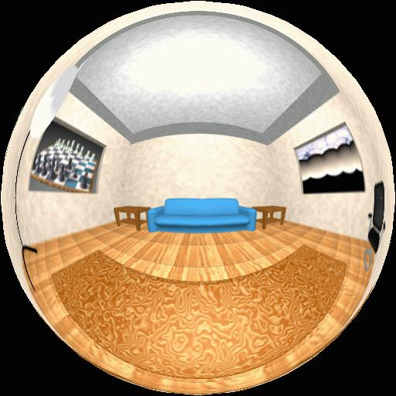

Review: Environment Mapping
cheap way to achieve reflective effect
  generate image of surrounding
  map to object as texture
sphere mapping: texture is distorted fisheye view
  point camera at mirrored sphere
  use spherical texture coordinates

Slide 45

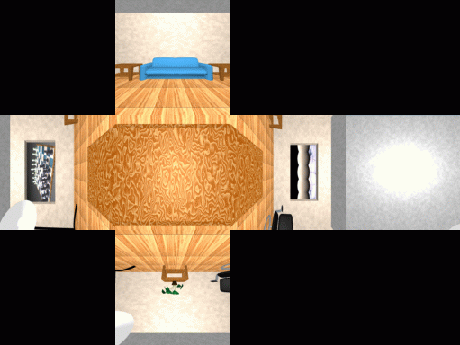
Review: Environment Cube Mapping
6 planar textures, sides of cube
  point camera in 6 different directions, facing out from origin

Slide 46
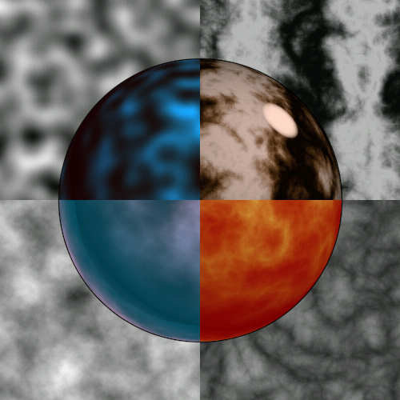
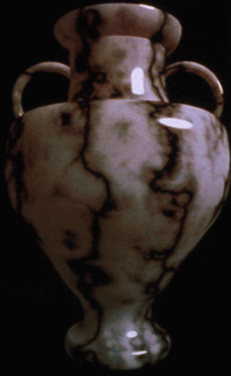
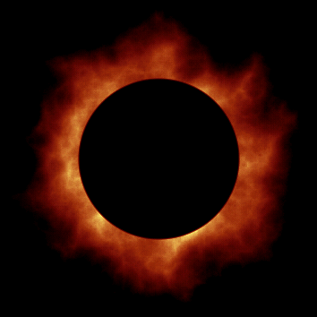
Review: Perlin Noise as Procedural Texture
several good explanations
http://www.noisemachine.com/talk1
http://freespace.virgin.net/hugo.elias/models/m_perlin.htm
http://www.robo-murito.net/code/perlin-noise-math-faq.html
http://mrl.nyu.edu/~perlin/planet/

Slide 47





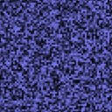

Review: Perlin Noise
coherency: smooth not abrupt changes
turbulence: multiple feature sizes

Slide 48
Ray Tracing

Slide 49
Review: Recursive Ray Tracing
ray tracing can handle
  reflection (chrome/mirror)
  refraction (glass)
  shadows
one primary ray per pixel
spawn secondary rays
  reflection, refraction
    if another object is hit, recurse to find its color
  shadow
    cast ray from intersection point to light source, check if intersects another object
  termination criteria
    no intersection (ray exits scene)
    max bounces (recursion depth)
    attenuated below threshold
Light
Source
Eye
Image Plane
Reflected
Ray
Shadow
Rays
Refracted
Ray

Slide 50
Review: Reflection and Refraction
n
reflection: mirror effects
  perfect specular reflection
refraction: at boundary
Snell’s Law
  light ray bends based on refractive indices c₁, c₂
d
n
t

Slide 51
Review: Ray Tracing
issues:
  generation of rays
  intersection of rays with geometric primitives
  geometric transformations
  lighting and shading
  efficient data structures so we don’t have to test intersection with every object

Slide 52
Backstory: 2D Parametric Lines
start at point p_{0,}
go towards p₁,
according to parameter t
  p(0) = p₀, p(1) = p₁

Slide 53
Review: Ray-Sphere Intersections, Lighting
Intersections: solving a set of equations
  Using implicit formulas for primitives
Direct illumination: gradient of implicit surface
Example: Ray-Sphere intersection
ray:
(unit) sphere:
quadratic equation in t :
Example: Sphere normals
v
p

Slide 54
Procedural/Collision

Slide 55
Review: Procedural Modeling
textures, geometry
  nonprocedural: explicitly stored in memory
procedural approach
  compute something on the fly
    not load from disk
  often less memory cost
  visual richness
    adaptable precision
noise, fractals, particle systems

Slide 56
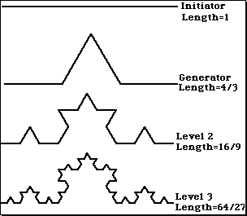
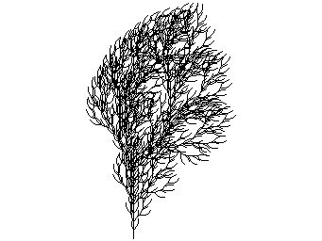
Review: Language-Based Generation
L-Systems
  F: forward, R: right, L: left
  Koch snowflake:
  F = FLFRRFLF
  Mariano’s Bush:
  F=FF-[-F+F+F]+[+F-F-F]
    angle 16
http://spanky.triumf.ca/www/fractint/lsys/plants.html

Slide 57




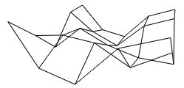

Review: Fractal Terrain
1D: midpoint displacement
  divide in half, randomly displace
  scale variance by half
2D: diamond-square
  generate new value at midpoint
  average corner values + random displacement
    scale variance by half each time
http://www.gameprogrammer.com/fractal.html

Slide 58
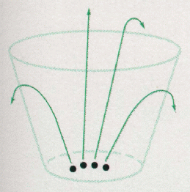
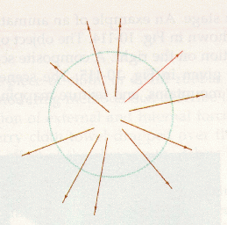
Review: Particle Systems
changeable/fluid stuff
  fire, steam, smoke, water, grass, hair, dust, waterfalls, fireworks, explosions, flocks
life cycle
  generation, dynamics, death
rendering tricks
  avoid hidden surface computations

Slide 59
Review: Collision Detection
boundary check
  perimeter of world vs. viewpoint or objects
    2D/3D absolute coordinates for bounds
    simple point in space for viewpoint/objects
set of fixed barriers
  walls in maze game
    2D/3D absolute coordinate system
set of moveable objects
  one object against set of items
    missile vs. several tanks
  multiple objects against each other
    punching game: arms and legs of players
    room of bouncing balls

Slide 60
Review: Collision Proxy Tradeoffs
collision proxy (bounding volume) is piece of geometry used to represent complex object for purposes of finding collision
proxies exploit facts about human perception
  we are bad at determining collision correctness
  especially many things happening quickly
Sphere
AABB
OBB
6-dop
Convex Hull
increasing complexity & tightness of fit
decreasing cost of (overlap tests + proxy update)

Slide 61
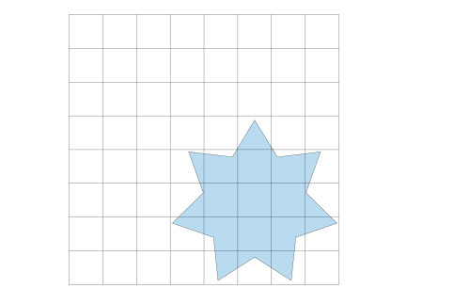
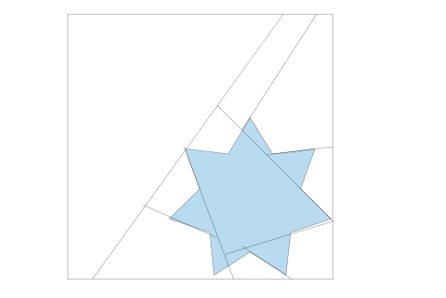
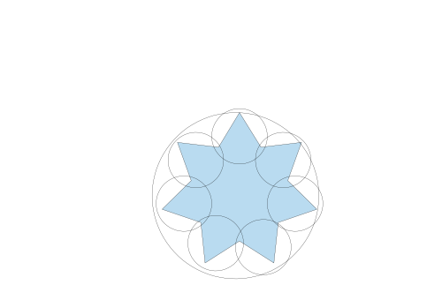
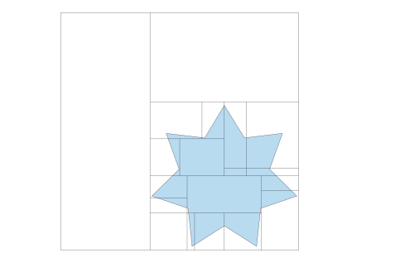

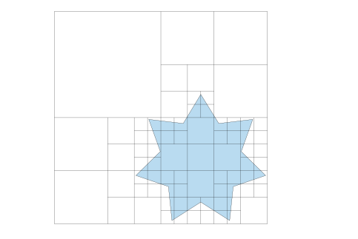
Review: Spatial Data Structures
uniform grids
bounding volume hierarchies
octrees
BSP trees
kd-trees
OBB trees
61

Slide 62
Hidden Surfaces / Picking / Blending

Slide 63
Review: Z-Buffer Algorithm
augment color framebuffer with Z-buffer or depth buffer which stores Z value at each pixel
  at frame beginning, initialize all pixel depths to ∞
  when rasterizing, interpolate depth (Z) across polygon
  check Z-buffer before storing pixel color in framebuffer and storing depth in Z-buffer
  don’t write pixel if its Z value is more distant than the Z value already stored there

Slide 64
Review: Depth Test Precision
  reminder: perspective transformation maps eye-space (VCS) z to NDC z
  thus: depth buffer essentially stores 1/z (for VCSz)
      high precision for near, low precision for distant

Slide 65
Review: Integer Depth Buffer
reminder from viewing discussion: depth ranges
  VCS range [zNear, zFar], NDCS range [-1,1], DCS z range [0,1]
convert fractional real number to integer format
  multiply by 2^n then round to nearest int
  where n = number of bits in depth buffer
24 bit depth buffer = 2^24 = 16,777,216 possible values
  small numbers near, large numbers far
consider VCS depth: z_{DCS} = (1<<N)*( a + b / z_{VCS} )
  N = number of bits of Z precision, 1<<N bitshift = 2^{n}
  a = zFar / ( zFar - zNear )
  b = zFar * zNear / ( zNear - zFar )
  z_{VCS} = distance from the eye to the object
Full derivation at https://www.opengl.org/archives/resources/faq/technical/depthbuffer.htm

Slide 66
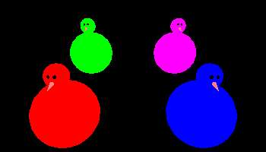
Review: Picking Methods
raycaster intersection support
offscreen buffer color coding
bounding extents
y
VCS
x

Slide 67
Review: Painter’s Algorithm
draw objects from back to front
problems: no valid visibility order for
  intersecting polygons
  cycles of non-intersecting polygons possible

Slide 68
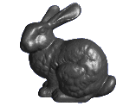
Review: BSP Trees
preprocess: create binary tree
  recursive spatial partition
  viewpoint independent

Slide 69
Review: BSP Trees
runtime: correctly traversing this tree enumerates objects from back to front
  viewpoint dependent: check which side of plane viewpoint is on at each node
  draw far, draw object in question,
  draw near
F
N
3
F
F
1
N
N
5
4
N
F
F
N
N
F
2
8
6
7
N
F
1
2
N
F
5
9
9
6
4
3
8
7

Slide 70
Review: Object Space Algorithms
determine visibility on object or polygon level
  using camera coordinates
resolution independent
  explicitly compute visible portions of polygons
early in pipeline
  after clipping
requires depth-sorting
  painter’s algorithm
  BSP trees

Slide 71
Review: Image Space Algorithms
  perform visibility test for in screen coordinates
    limited to resolution of display
    Z-buffer: check every pixel independently
  performed late in rendering pipeline

Slide 72
Review: Back-face Culling
VCS
y
y
z
eye
z
eye
VCS: cull if angle between eye-face vector and normal > 90
NDCS
eye
y
z
NDCS: cull if

Slide 73
Review: Invisible Primitives
why might a polygon be invisible?
  polygon outside the field of view / frustum
    solved by clipping
  polygon is backfacing
    solved by backface culling
  polygon is occluded by object(s) nearer the viewpoint
    solved by hidden surface removal

Slide 74
Review: Blending with Premultiplied Alpha
specify opacity with alpha channel α
  α=1: opaque, α=.5: translucent, α=0: transparent
how to express a pixel is half covered by a red object?
  obvious way: store color independent from transparency (r,g,b,α)
    intuition: alpha as transparent colored glass
      100% transparency can be represented with many different RGB values
    pixel value is (1,0,0,.5)
    upside: easy to change opacity of image, very intuitive
    downside: compositing calculations are more difficult - not associative
  elegant way: premultiply by α so store (αr, αg, αb,α)
    intuition: alpha as screen/mesh
      RGB specifies how much color object contributes to scene
      alpha specifies how much object obscures whatever is behind it (coverage)
      alpha of .5 means half the pixel is covered by the color, half completely transparent
      only one 4-tuple represents 100% transparency: (0,0,0,0)
    pixel value is (.5, 0, 0, .5)
    upside: compositing calculations easy (& additive blending for glowing!)
    downside: less intuitive

Slide 75
Color

Slide 76
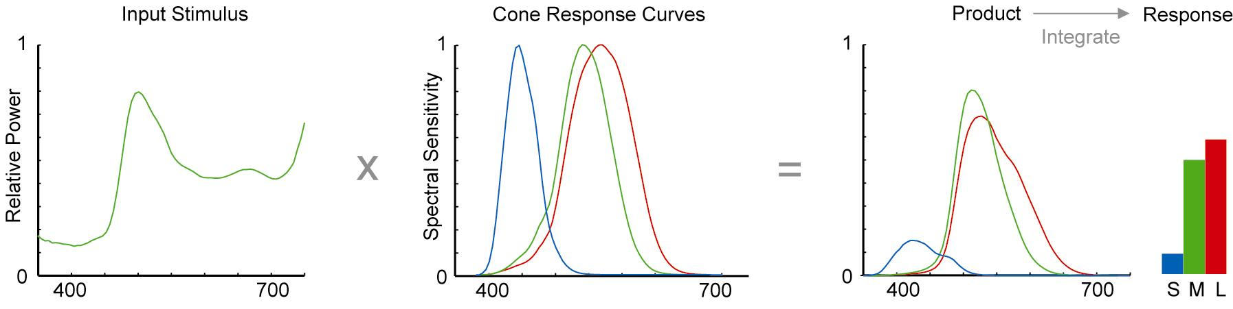
Backstory & Review: Trichromacy
trichromacy
  three types of cones: S, M, L
  color is combination of cone stimuli
    different cone responses: area function of wavelength
for a given spectrum
  multiply by responses curve
  integrate to get response
From A Field Guide to Digital Color, © A.K. Peters, 2003
Notes:
Talk about spectral distribution function, area is intensity

Slide 77
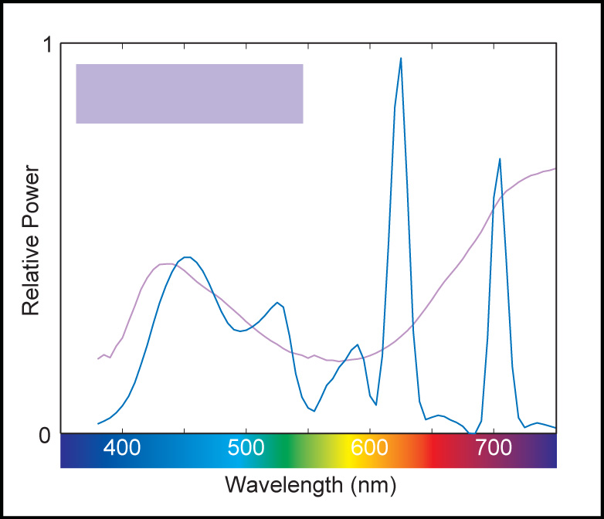
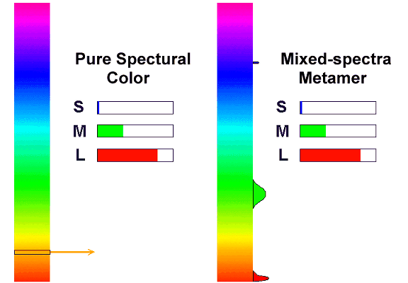
Review: Metamers
brain sees only cone response
  different spectra appear the same: metamers

Slide 78
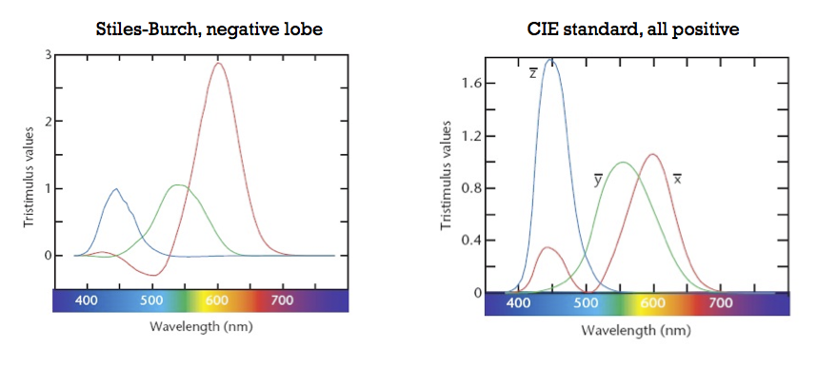
Review: Measured vs. CIE XYZ Color Spaces
measured basis
  monochromatic lights
  physical observations
  negative lobes
transformed basis
  “imaginary” lights
  all positive, unit area
  Y is luminance

Slide 79
Backstory: Spectral Sensitivity Curve

Slide 80
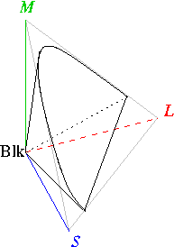
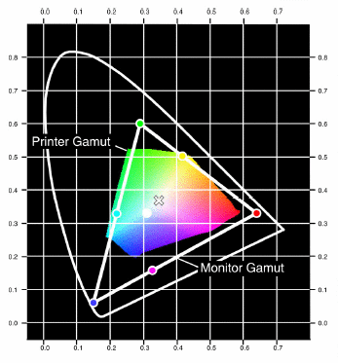
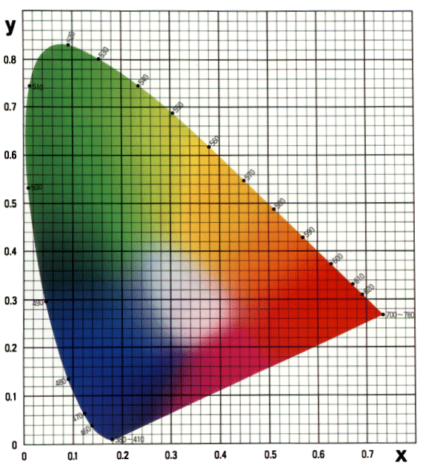
Review: CIE Chromaticity Diagram and Gamuts
plane of equal brightness showing chromaticity
gamut is polygon, device primaries at corners
  defines reproducible color range

Slide 81
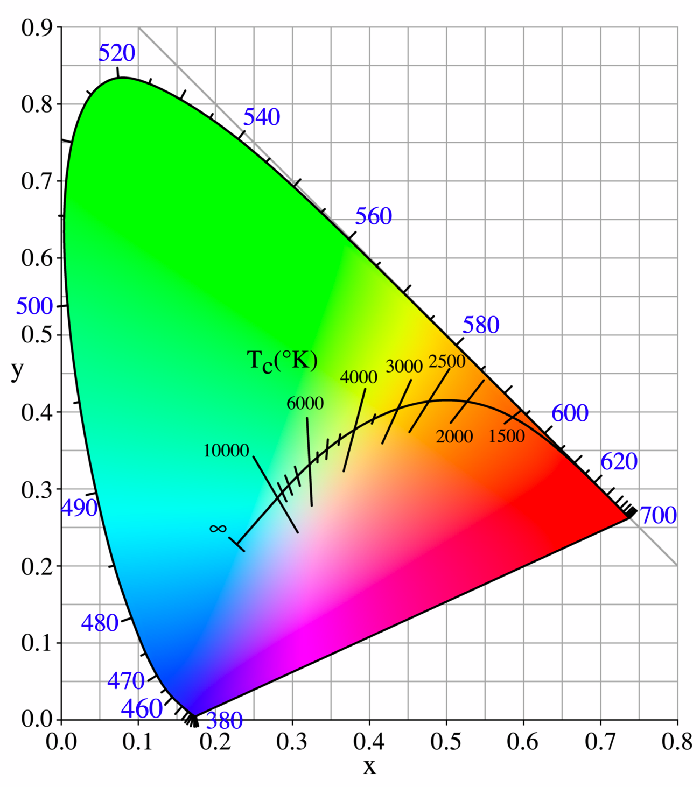
Review: Blackbody Curve
illumination:
  candle
  2000K
  A: Light bulb
  3000K
  sunset/
  sunrise
  3200K
  D: daylight
  6500K
  overcast
  day 7000K
  lightning
  >20,000K

Slide 82
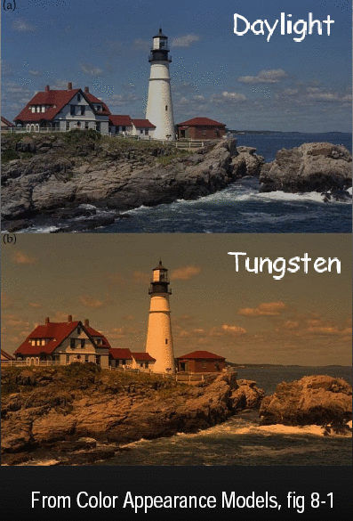

Review: Color Constancy
automatic “white balance” from change in illumination
vast amount of processing behind the scenes!
colorimetry vs. perception

Slide 83


Review: RGB Color Space (Color Cube)
define colors with (r, g, b) amounts of red, green, and blue
  used by OpenGL
  hardware-centric
RGB color cube sits within CIE color space
  subset of perceivable colors
  scale, rotate, shear cube

Slide 84





Review: HSV Color Space
hue: dominant wavelength, “color”
saturation: how far from grey
value: how far from black/white
  aka brightness, intensity: HSB / HSV / HSI similar
cannot convert to RGB with matrix alone

Slide 85
Review: HSI/HSV and RGB
HSV/HSI conversion from RGB
  hue same in both
  value is max, intensity is average
HSI:
HSV:

Slide 86

Review: YIQ Color Space
I
color model used for color TV
  Y is luminance (same as CIE)
  I & Q are color (not same I as HSI!)
  using Y backwards compatible for B/W TVs
  conversion from RGB is linear
    green is much lighter than red, and red lighter than blue
Q

Slide 87

Review: Luminance vs. Intensity
luminance
  Y of YIQ
  0.299R + 0.587G + 0.114B
  captures important factor
intensity/value/brightness
  I/V/B of HSI/HSV/HSB
  0.333R + 0.333G + 0.333B
  not perceptually based
www.csse.uwa.edu.au/~robyn/Visioncourse/colour/lecture/node5.html

Slide 88
Visualization

Slide 89
Review: Marks and Channels
marks
  geometric primitives
channels
  control appearance of marks

Slide 90

Review: Channel Rankings
expressiveness principle
match channel and data characteristics
effectiveness principle
encode most important attributes with highest ranked channels

