Slide 1
CPSC 314
TEXTURE MAPPING
UGRAD.CS.UBC.CA/~cs314
Glen Berseth (Based of Mikhail Bessmeltsev and Dinesh Pai)

Slide 2
PROBLEMS ON ILLUMINATION
(whiteboard)

Slide 3
CODING A3 & THEORY A3
Out tonight
Coding A3 (due Nov, 6th):
Lighting & Shading
A bit of texturing
Theory A3 (due Oct, 30th, in class):
Clipping
Rasterization
Lighting & Shading

Slide 4
SOME HINTS ON THEORY A3

Slide 5
SHAPES - CURVES/SURFACES
Mathematical representations:
Explicit functions
Parametric functions
Implicit functions

Slide 6
SHAPES: EXPLICIT FUNCTIONS
y := sin (x)
Curves:
y is a function of x:
Only works in 2D
Surfaces:
z is a function of x and y:
Cannot define arbitrary shapes in 3D
z := sin( x) + cos( y)

Slide 7
SHAPES: PARAMETRIC FUNCTIONS
Curves:
2D: x and y are functions of a parameter value t
3D: x, y, and z are functions of a parameter value t
⎛ cos(t)⎞
⎜ ⎟
C(t) := ⎜ sin(t) ⎟
⎜
t
⎟
⎝
⎠

Slide 8
SHAPES: PARAMETRIC FUNCTIONS
Surfaces:
Surface S is defined as a function of parameter values s, t
Names of parameters can be different to match intuition:
⎛ cos(φ ) cos(θ ) ⎞
⎜ ⎟
S (φ,θ ) := ⎜ sin(φ ) cos(θ ) ⎟
⎜
sin(θ )
⎟
⎝
⎠

Slide 9
SHAPES: IMPLICIT
Surface (3D) or Curve (2D) defined by zero set (roots) of function
E.g:
S(x, y, z) : x² + y ² + z ² −1 = 0

Slide 10
HOW TO INTERSECT ?
Two lines in 2D?
A line and a plane?
A line and a sphere?
(Whiteboard)

Slide 11
FACE-TO-FACE GRADING
No show = no grade!
If you don’t understand something in your own code, we’ll deduct points
Your chance to make sure TA marks everything you did

Slide 12
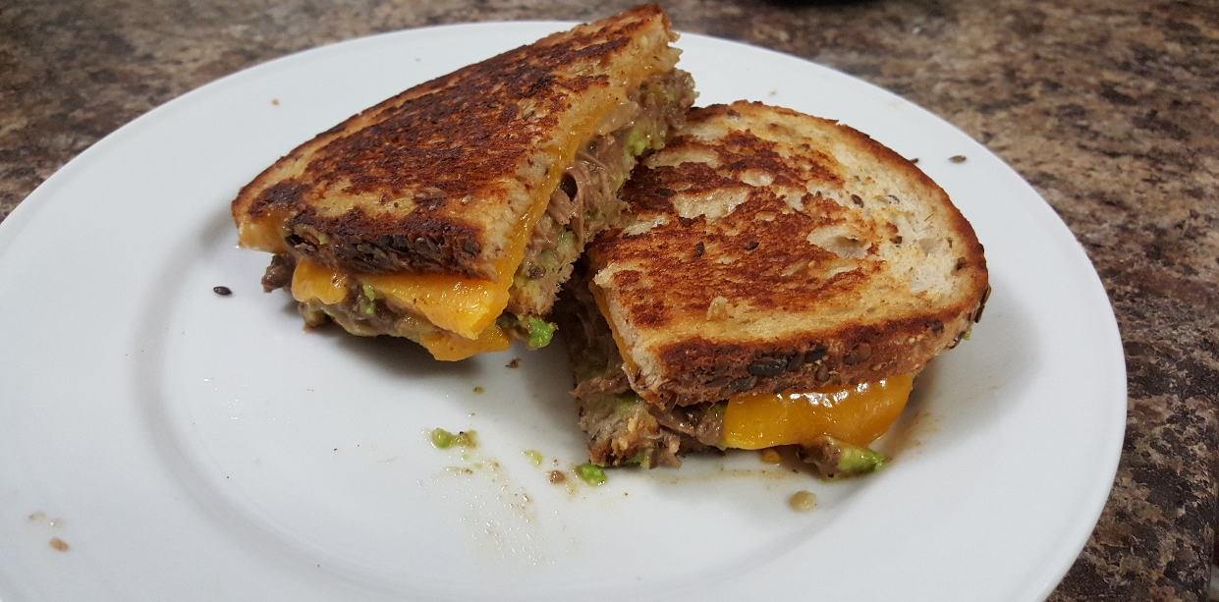
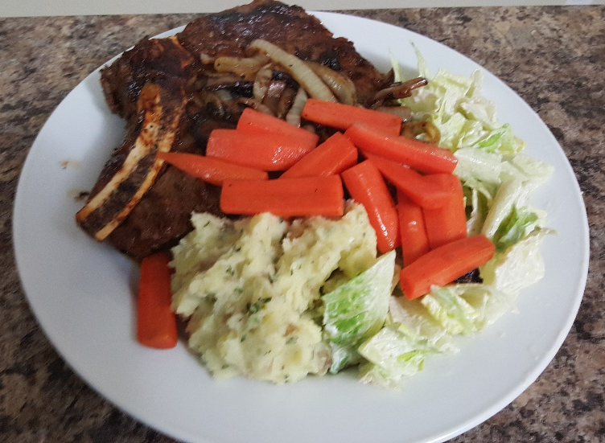
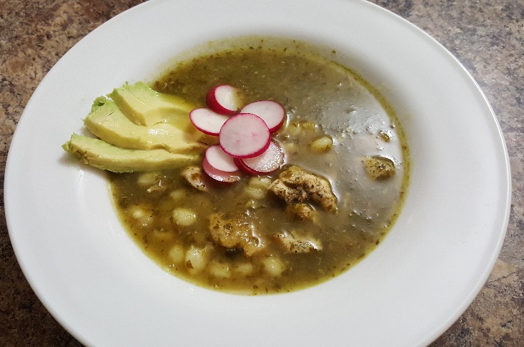
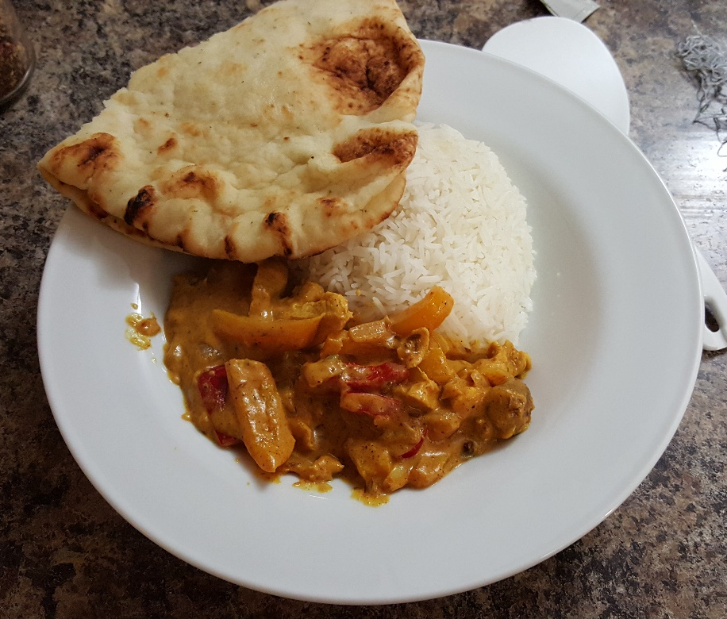
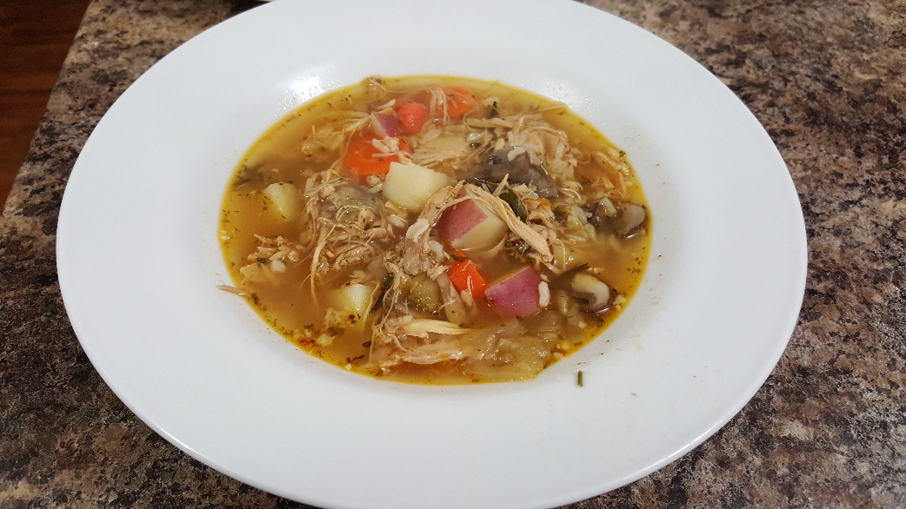
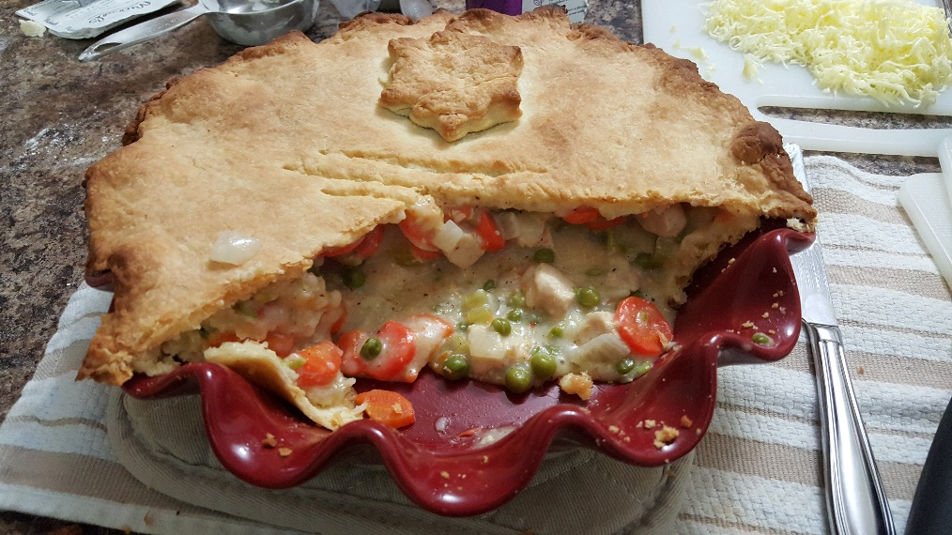
WHY IS TEXTURE IMPORTANT?
12

Slide 13
TEXTURE MAPPING
real life objects have nonuniform colors, normals
to generate realistic objects, reproduce coloring & normal variations = texture
can often replace complex geometric details
12

Slide 14
TEXTURE MAPPING
hide geometric simplicity
images convey illusion of geometry
map a brick wall texture on a flat polygon
create bumpy effect on surface
usually:
associate 2D information with a surface in 3D
point on surface ↔ point in texture
“paint” image onto polygon

Slide 15
COLOR TEXTURE MAPPING
define color (RGB) for each point on object surface
other:
volumetric texture
procedural texture

Slide 16
TEXTURE MAPPING
v
(u₂,v₂)
1
(u₀,v₀)
(u₁,v₁)
0
u
0
1
(u, v) parameterization
sometimes called (s,t)

Slide 17
TEXTURE MAPPING – Questions?

Slide 18
SURFACE TEXTURE
Define texture pattern over (u,v) domain (Image)
Image – 2D array of “texels”
Assign (u,v) coordinates to each point on object surface
How: depends on surface type
For polygons (triangle)
Inside – use barycentric coordinates
For vertices need mapping function (artist/programmer)
v
u

Slide 19
TEXTURE MAPPING EXAMPLE
+
=

Slide 20
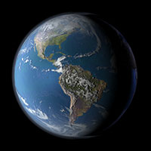
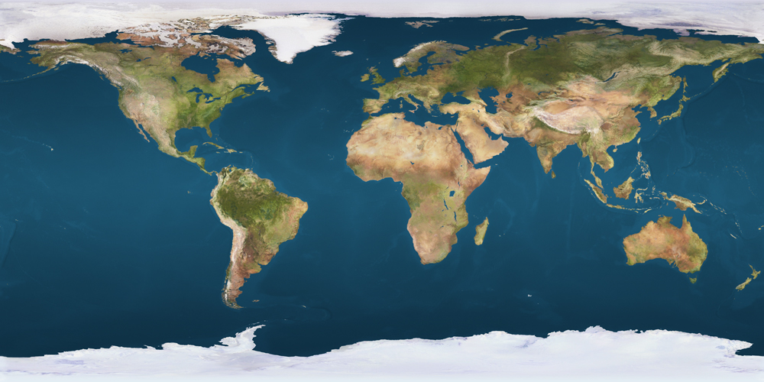
TEXTURE MAPPING EXAMPLE

Slide 21
TEXTURE MAPPING EXAMPLE
Pause …. --> Math Example

Slide 22
FRACTIONAL TEXTURE COORDINATES
texture image
(0,1)
(1,1)
(0,0)
(1,0)

Slide 23
THREE.JS
pass texture as a uniform:
var uniforms = {
texture1: { type: "t", value: THREE.ImageUtils.loadTexture(
var material = new THREE.ShaderMaterial( { uniforms, …});
"texture.jpg"
) }};
uv will be passed on to the vertex shader (no need to write this):
attribute vec2 uv;
use it, e.g., in Fragment Shader:
uniform sampler2D texture1;
varying vec2 texCoord;
vec4 texColor = texture2D(texture1,
texCoord);

Slide 24
HOW TO USE COLOR TEXTURES
Replace
Set fragment color to texture color
gl_FragColor = texColor;
Modulate
Use texture color as reflection color in illumination equation
kd = texColor; | ka = | texColor;
gl_FragColor = | ka*ia | + kd*id*dotProduct | + | …;

Slide 25
TEXTURE LOOKUP: TILING AND CLAMPING
What if s or t is outside [0…1] ?
Multiple choices
Use fractional part of texture coordinates
Cyclic repetition (repeat)
Clamp every component to range [0…1]
Re-use color values from texture image border

Slide 26
IN THREE.JS
var texture
= THREE.ImageUtils.loadTexture(
"textures/water.jpg" );
texture.wrapS texture.wrapT
= THREE.RepeatWrapping;
= THREE.ClampToEdgeWrapping;
texture.repeat.set(
4, 4 );

Slide 27
TILED TEXTURE MAP
(1,0)
(1,1)
(0,0)
(0,1)
23
(4,0)
(4,4)
(0,0)
(0,4)

Slide 28
RECONSTRUCTION
(image courtesy of Kiriakos Kutulakos, U Rochester)

Slide 29
RECONSTRUCTION
how to deal with:
pixels that are much larger than texels?
minification
pixels that are much smaller than texels ?
magnification

Slide 30
MIPMAPPING
use “image pyramid” to precompute averaged versions of the texture
Without MIP-mapping
store whole pyramid in single block of memory
With MIP-mapping

Slide 31
MIPMAPS
multum in parvo -- many things in a small place
prespecify a series of prefiltered texture maps of decreasing resolutions
requires more texture storage
avoid shimmering and flashing as objects move
texture.generateMipmaps = true
automatically constructs a family of textures from original texture size down to 1x1
texture.mipmaps[…]
without with

Slide 32
MIPMAP STORAGE
only 1/3 more space required

Slide 33
HOW TO INTERPOLATE S,T?

Slide 34
TEXTURE MAPPING
Texture coordinate interpolation
Perspective foreshortening problem
Also problematic for color interpolation, etc.

Slide 35
INTERPOLATION: SCREEN VS. WORLD SPACE
Screen space interpolation incorrect under perspective
Problem ignored with shading, but artifacts more visible with texturing
P₀(x,y,z)
V₀(x’,y’)
V₁(x’,y’)
P₁(x,y,z)

Slide 36
INTERPOLATION: SCREEN VS. WORLD SPACE
Screen space interpolation incorrect under perspective
Problem ignored with shading, but artifacts more visible with texturing
P₀(x,y,z)
V₀(x’,y’)
V₁(x’,y’)
P₁(x,y,z)

Slide 37
PERSPECTIVE - REMINDER
⎛ ⎡ x⎤ ⎞
⎡1 0 0
1 0
0 a
0 − 1
0⎤⎡ x⎤
⎜ ⎢ ⎥ ⎟
⎢
⎥⎢ ⎥
a ⋅ z + b
b ^{z}eye
eye
_{T} ⎜ ⎢ ^{y}⎥ ⎟ ₌ ⎢⁰
⁰⎥⎢ ^{y}⎥ z
b⎥⎢ z ⎥
=
= a +
⎜ _{⎢ z ⎥} ⎟
⎢0
NDC
⎜ ⎟
^{z}eye
⎜ ⎢₁⎥ ⎟ ⎢₀
₀⎥⎢₁⎥
⎝ ⎣ ⎦ ⎠ ⎣
⎦⎣ ⎦
Preserves order
BUT distorts distances

Slide 38
TEXTURE COORDINATE INTERPOLATION
Perspective Correct Interpolation
α, β, γ : Barycentric coordinates (2D) of point P
•
•
s₀, s₁, s₂ :
texture coordinates of vertices
w₀, w₁,w₂ : homogenous coordinate of vertices
(𝑠₎, 𝑡₎) (𝑥*,𝑦* , 𝑧*, 𝑤* )
_{s =} α ⋅ s₀ / w₀ + β ⋅ s₁ / w₁ + γ ⋅ s₂ / w₂
(s,t)?
(α,β,γ)
α / w₀ + β / w₁ + γ / w₂
(𝑠#, 𝑡#)
(𝑥#, 𝑦# , 𝑧# , 𝑤# )
(𝑠 , 𝑡 )
) )
(𝑥₎, 𝑦₎ , 𝑧₎, 𝑤₎ )
Similarly for t
Derivation (similar triangles): https://www.comp.nus.edu.sg/~lowkl/publications
/lowk_persp_interp_techrep.pdf

Slide 39
OTHER USES FOR TEXTURES

Slide 40
OTHER USES FOR TEXTURES
usually provides colour, but …
can also use to control other material/object properties
surface normal (bump mapping)
reflected color (environment mapping)

Slide 41
BUMP MAPPING: NORMALS AS TEXTURE
object surface often not smooth – to recreate correctly need complex geometry model
can control shape “effect” by locally perturbing surface normal
random perturbation
directional change over region

Slide 42
BUMP MAPPING

Slide 43
BUMP MAPPING

Slide 44
EMBOSSING
at transitions
rotate point’s surface normal by θ or - θ

Slide 45
BUMP MAPPING: LIMITATION

Slide 46
BUMP MAPPING: LIMITATION
Why don’t we modify geometry instead of modifying normals?

Slide 47
DISPLACEMENT MAPPING
bump mapping gets silhouettes wrong
shadows wrong too
change surface geometry instead
only recently available with realtime graphics
need to subdivide surface
https://en.wikipedia.org /wiki/Displacement_map ping#/media/File:Displacement.jpg

Slide 48
ENVIRONMENT MAPPING
cheap way to achieve reflective effect
generate image of surrounding
map to object as texture

Slide 49
ENVIRONMENT MAPPING
used to model object that reflects surrounding textures to the eye
movie example: cyborg in Terminator 2
different approaches
sphere, cube most popular
others possible too

Slide 50
SPHERE MAPPING
texture is distorted fish-eye view
point camera at mirrored sphere
spherical texture mapping creates texture coordinates that correctly index into this texture map

Slide 51
CUBE MAPPING
6 planar textures, sides of cube
point camera in 6 different directions, facing out from origin

Slide 52
CUBE MAPPING
F
A
C
B
E
D

Slide 53
CUBE MAPPING
direction of reflection vector r selects the face of the cube to be indexed
co-ordinate with largest magnitude
e.g., the vector (-0.2, 0.5, -0.84) selects the –Z face
remaining two coordinates select the pixel from the face.
difficulty in interpolating across faces

Slide 54
CUBE MAPPING
how to
calculate?
direction of reflection vector r selects the face of the cube to be indexed
co-ordinate with largest magnitude
e.g., the vector (-0.2, 0.5, -0.84) selects the –Z face
remaining two coordinates select the pixel from the face.
difficulty in interpolating across faces

Slide 55
ENVIRONMENT MAPS (EM)
in theory, every object should have a separate EM
in theory, every time something moves, you should re-compute EM
“you’ll be surprised at what you can get away with”

Slide 56
VOLUMETRIC TEXTURE
define texture pattern over 3D domain - 3D space containing the object
texture function can be digitized or procedural
for each point on object compute texture from point location in space
e.g., ShaderToy
computing is cheap,
memory access is expensive !

Slide 57
PROCEDURAL TEXTURE EFFECTS: BOMBING
randomly drop bombs of various shapes, sizes and orientation into texture space (store data in table)
for point P search table and determine if inside shape
if so, color by shape’s color
otherwise, color by object’s color

Slide 58
PERLIN NOISE: PROCEDURAL TEXTURES
several good explanations
http://www.noisemachine.com/talk1
http://freespace.virgin.net/hugo.elias/models/m_perlin.htm
http://www.robo-murito.net/code/perlin-noise-math-faq.html
http://mrl.nyu.edu/~perlin/planet/

Slide 59
PERLIN NOISE: TURBULENCE
multiple feature sizes
add scaled copies of noise

Slide 60
PERLIN NOISE: TURBULENCE
multiple feature sizes
add scaled copies of noise

Slide 61
THE RENDERING PIPELINE
Vertices
Vertex Shader
Vertex Post-Processing
and attributes
Modelview transform
Viewport transform
Per-vertex attributes
Clipping
Rasterization
Fragment Shader
Scan conversion
Texturing/...
Interpolation
Lighting/shading
Per-Sample Operations
Framebuffer
Depth test
Blending

Slide 62
SHADOWS

Slide 63
SHADOWS
Need at least 2 shader passes:
1. Draw everything as it’s viewed from the LIGHT SOURCE

Slide 64
SHADOWS
Need at least 2 shader passes:
1. Draw everything as it’s viewed from the LIGHT SOURCE
Depth per pixel (‘depth map’)

Slide 65
SHADOWS (IDEA)
Need at least 2 shader passes:
Draw everything as it’s viewed from the LIGHT SOURCE
Depth per pixel (‘depth map’).
Now draw everything from CAMERA
When computing color per pixel:
Find corresponding depth map pixel: D - distance from light source
Is distance from me to the camera > D?
• Yes: I am occluded! I’m in SHADOW.
• No: I’m LIT!

Slide 66
SHADOWS (IDEA)
Need at least 2 shader passes:
Draw everything as it’s viewed from the LIGHT SOURCE
Depth per pixel (‘depth map’).
Now draw everything from CAMERA
When computing color per pixel:
Find corresponding depth map pixel: D - distance from light source
Is distance from me to the camera > D?
• Yes: I am occluded! I’m in SHADOW.
• No: I’m LIT!

