Slide 1
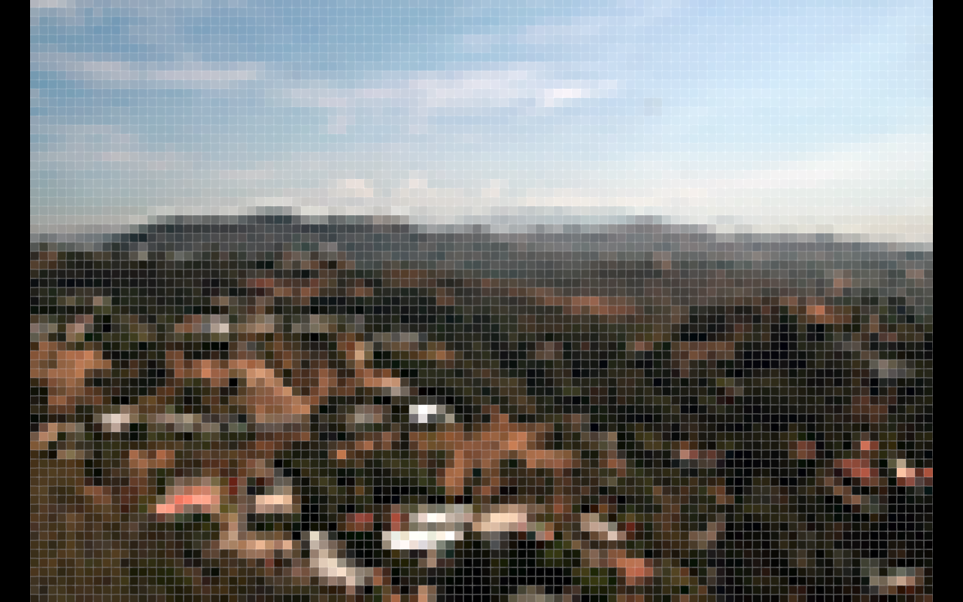
CPSC 314
Lighting and SHADING ugrad.cs.ubc.ca/~cs314
slide credits: Mikhail Bessmeltsev et al

Slide 2
The Rendering Pipeline

Slide 3
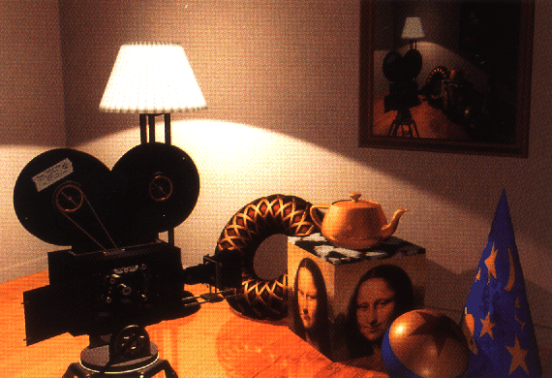
Lighting/Shading
Goal
  Model the interaction of light with surfaces to render realistic images
  Generate per (pixel/vertex) color

Slide 4
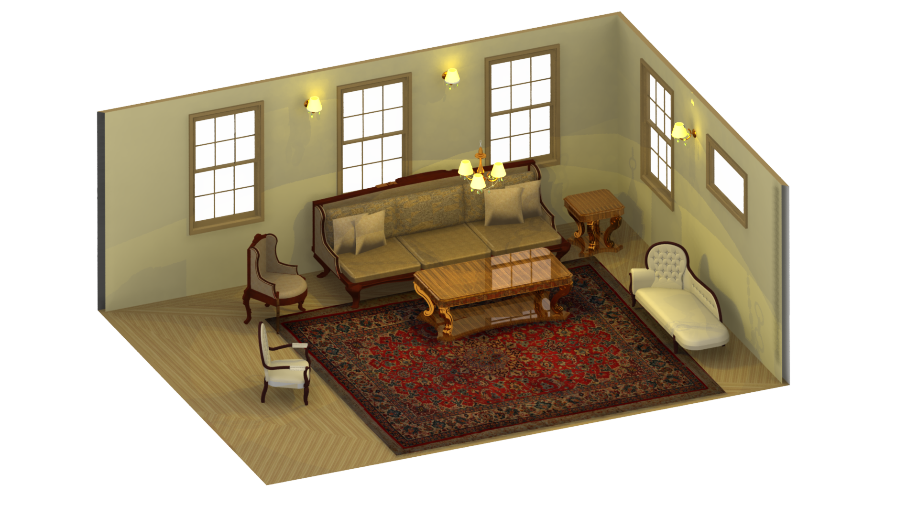
Factors
Light sources
  Location, type & color
Surface materials
  How surfaces reflect light
Transport of light
  How light moves in a scene
Viewer position

Slide 5
Factors
Light sources
  Location, type & color
Surface materials
  How surfaces reflect light
Transport of light
  How light moves in a scene
Viewer position
How can we do this in the pipeline?

Slide 6
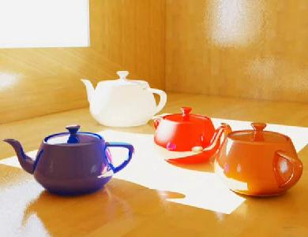

Illumination Models/Algorithms
Local illumination - Fast
  Ignore real physics, approximate the look
  Interaction of each object with light
    Compute on surface (light to viewer)
Global illumination – Slow
  Physically based
  Interactions between objects

Slide 7
The big picture (basic)
Light: energy in a range of wavelengths
  White light – all wavelengths
  Colored (e.g. red) – subset of wavelengths
Surface “color” – reflected wavelength
  White – reflects all lengths
  Black – absorbs everything
  Colored (e.g. red) absorbs all but the reflected color
Multiple light sources add (energy sums)

Slide 8
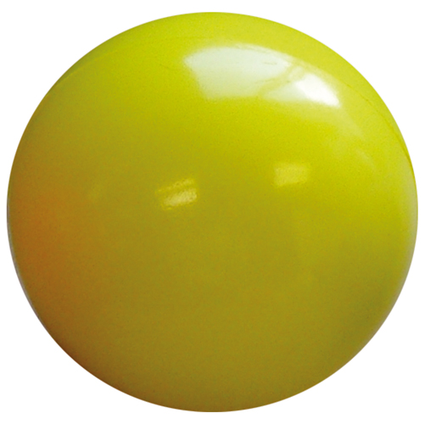
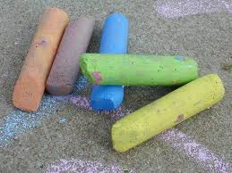

Materials
Surface reflectance:
  Illuminate surface point with a ray of light from different directions
  How much light is reflected in each direction?

Slide 9
Basic Types

Slide 10
Reflectance Distribution Model
Most surfaces exhibit complex reflectances
  Vary with incident and reflected directions.
  Model with combination – known as BRDF
    BRDF: Bidirectional Reflectance Distribution Function
  + + =

Slide 11
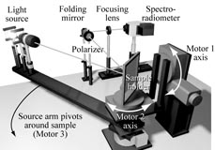
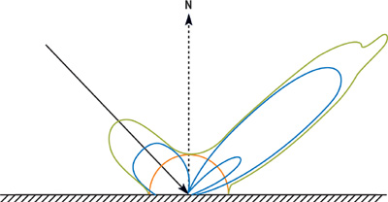
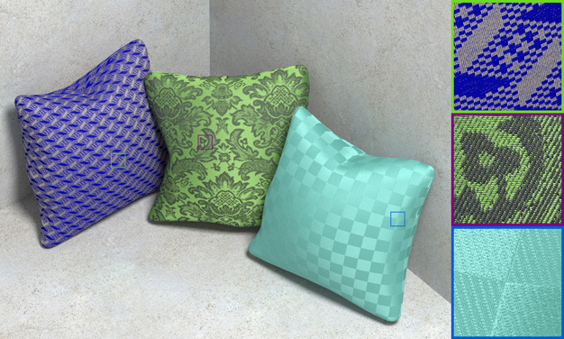
BRDF measurements/plots
2D slice

Slide 12
Surface Roughness
at a microscopic scale, all real surfaces are rough
cast shadows on themselves
“mask” reflected light:
shadow
shadow
Masked Light

Slide 13
Surface Roughness
notice another effect of roughness:
  each “microfacet” is treated as a perfect mirror.
  incident light reflected in different directions by different facets.
  end result is mixed reflectance.
    smoother surfaces are more specular or glossy.
    random distribution of facet normals results in diffuse reflectance.
Notes:
Average local facet normal can be used to approximate local surface normal.

Slide 14
Physics of Diffuse Reflection
ideal diffuse reflection
  very rough surface at the microscopic level
    real-world example: chalk
  microscopic variations mean incoming ray of light equally likely to be reflected in any direction over the hemisphere
  what does the reflected intensity depend on?

Slide 15
Lambert’s Cosine Law
ideal diffuse surface reflection
  the energy reflected by a small portion of a surface from a light source in a given direction is proportional to the cosine of the angle between that direction and the surface normal
reflected intensity
  independent of viewing direction
  depends on surface orientation wrt light
often called Lambertian surfaces

Slide 16
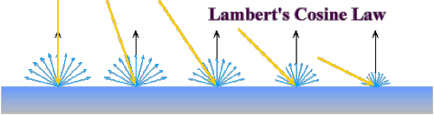
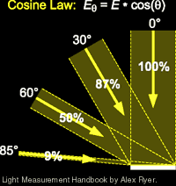
DIFFUSE (Lambert)
Intuitively: cross-sectional area of
the “beam” intersecting an element
of surface area is smaller for greater
angles with the normal.

Slide 17
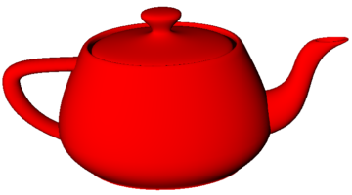
Computing Diffuse Reflection
  Depends on angle of incidence: angle between surface normal and incoming light
    I_{diffuse} = k_{d} I_{light} cos θ
  In practice use vector arithmetic
    I_{diffuse} = k_{d} I_{light} (n • l)
  Scalar (B/W intensity) or 3-tuple (color)
    k_{d}: diffuse coefficient, surface color
    I_{light}: incoming light intensity
    I_{diffuse}: outgoing light intensity (for diffuse reflection)
  NB: Always normalize vectors used in lighting!!
    n, l should be unit vectors
l
n
θ

Slide 18
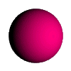
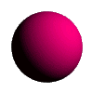
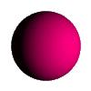
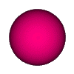
Diffuse Lighting Examples
  Lambertian sphere from several lighting angles:
  need only consider angles from 0° to 90°

Slide 19
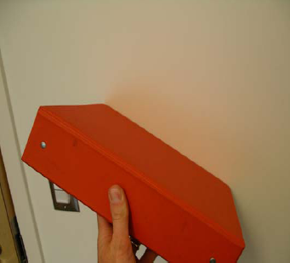
Diffuse Interreflection

Slide 20
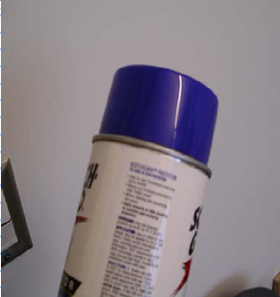
Specular Highlights
Michiel van de Panne

Slide 21
Physics of Specular Reflection
Geometry of specular (perfect mirror) reflection
  Snell’s law special case: Law of Reflection
n
l
r
= -l+2(n•l)n
(n•l)n
α
α
-l

Slide 22
Physics of Specular Reflection
Geometry of specular (perfect mirror) reflection
  Snell’s law special case: Law of Reflection
  In GLSL: use reflect(-l,n)
n
l
r
= -l+2(n•l)n
(n•l)n
α
α
-l

Slide 23
Calculating R Vector
  P = N cos θ |L| |N| projection of L onto N
  P = N cos θ L, N are unit length
  P = N ( N · L )
  2 P = R + L
  2 P – L = R
  2 (N ( N · L )) - L = R
L
P
N
P
L
θ
R

Slide 24
Empirical Approximation
Snell’s law = perfect mirror-like surfaces
  But ..
    few surfaces exhibit perfect specularity
    Gaze and reflection directions never EXACTLY coincide
Expect most reflected light to travel in direction predicted by Snell’s Law
But some light may be reflected in a direction slightly off the ideal reflected ray
As angle from ideal reflected ray increases, we expect less light to be reflected

Slide 25
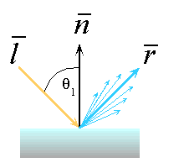
Empirical Approximation
Angular falloff
How to model this falloff?

Slide 26
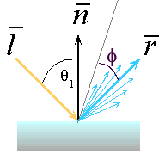
Phong Lighting
Most common lighting model in computer graphics (Phong Bui-Tuong, 1975)
v
ϕ: angle between r and view direction v
n_{s} : purely empirical constant, varies rate of falloff
k_{s}: specular coefficient, highlight color
no physical basis, “plastic” look
reminder: normalize all vectors: n,l,r,v

Slide 27
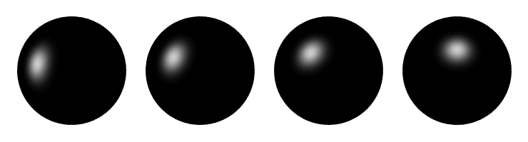
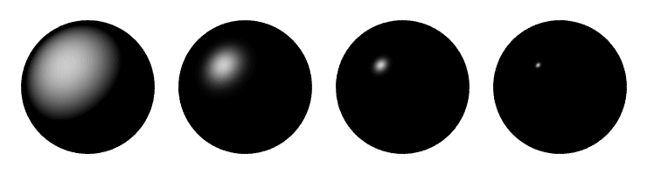
Phong Examples
varying light position
varying n_{s}

Slide 28
Alternative Model
Blinn-Phong model (Jim Blinn, 1977)
Variation with better physical interpretation
  h: halfway vector; r: roughness
n
h
v
l
α
α

Slide 29
MultIPLE LIGHTS
Light is linear
  If multiple rays illuminate the surface point the result is just the sum of the individual reflections for each ray

Slide 30

Ambient Light
Non-directional light – environment light
Object illuminated with same light everywhere
  Looks like silhouette
Illumination equation
  - ambient light intensity
  - fraction of this light reflected from surface

Slide 31
Light Sources
ambient lights
  no identifiable source or direction
  hack for replacing true global illumination
    (diffuse interreflection: light bouncing off from other objects)

Slide 32
ILLUMINATION EQUATION (PHONG)
If we take the previous formula and add ambient component:

Slide 33
Light
Light has color
Interacts with object color (r,g,b)
Blue light on white surface?
Blue light on red surface?

Slide 34
Light and Material Specification
Light source: amount of RGB light emitted
  value = intensity per channel
  e.g., (1.0,0.5,0.5)
  every light source emits ambient, diffuse, and specular light
Materials: amount of RGB light reflected
  value represents percentage reflected
  e.g., (0.0,1.0,0.5)
Interaction: multiply components
  Red light (1,0,0) x green surface (0,1,0) = black (0,0,0)

Slide 35
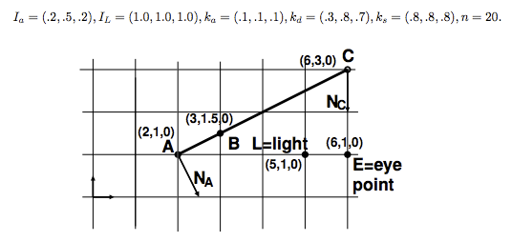
WHITEBOARD EXAMPLE

Slide 36
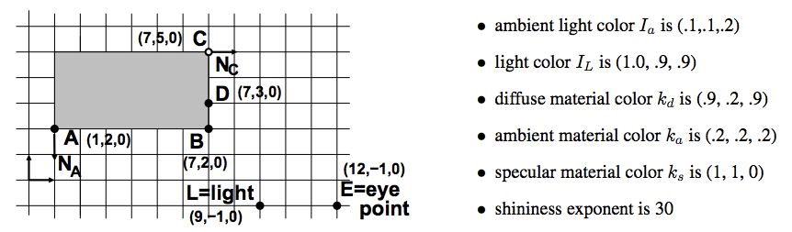
WHITEBOARD EXAMPLE

Slide 37
Light Source Types
Point Light
  light originates at a point
Directional Light (point light at infinity)
  light rays are parallel
  Rays hit a planar surface at identical angles
Spot Light
  point light with limited angles

Slide 38
Light Source Types
Point Light
  light originates at a point
  defined by location only
Directional Light (point light at infinity)
  light rays are parallel
  Rays hit a planar surface at identical angles
  defined by direction only
Spot Light
  point light with limited angles
  defined by location, direction, and angle range

Slide 39
Light Sources
area lights
  light sources with a finite area
  more realistic model of many light sources
  much more complex!

Slide 40
WHICH LIGHTS/MATERIALS ARE USED HERE?

Slide 41
Light Source Falloff
Quadratic falloff (point- and spot lights)
  Brightness of objects depends on power per unit area that hits the object
  The power per unit area for a point or spot light decreases quadratically with distance
Area 4πr²
Area 4π(2r)²

Slide 42
Illumination Equation With ATTENUATION
For multiple light sources:
- distance between surface and light source + distance between surface and viewer, A – attenuation function

Slide 43
When to apply Lighting Model?
per polygon
“flat shading”
per vertex
“Gouraud shading”
per pixel
“per pixel lighting”
“Phong shading”
Image © Intergraph Computer Systems

Slide 44
Lighting vs. Shading
lighting
  process of computing the luminous intensity (i.e., outgoing light) at a particular 3-D point, usually on a surface
shading
  the process of assigning colors to pixels
  (why the distinction?)

Slide 45
Applying Illumination
we now have an illumination model for a point on a surface
if surface defined as mesh of polygonal facets, which points should we use?
  fairly expensive calculation
  several possible answers, each with different implications for visual quality of result

Slide 46
Applying Illumination
polygonal/triangular models
  each facet has a constant surface normal
  if light is directional, diffuse reflectance is constant across the facet
  why?

Slide 47
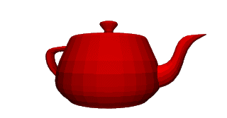
Flat Shading
simplest approach calculates illumination at a single point for each polygon
obviously inaccurate for smooth surfaces

Slide 48
Flat Shading Approximations
if an object really is faceted, is this accurate?
no!
  for point sources, the direction to light varies across the facet
  for specular reflectance, direction to eye varies across the facet

Slide 49
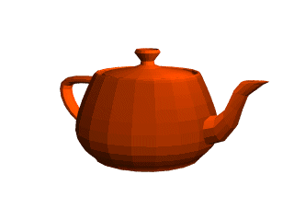
Improving Flat Shading
what if evaluate Phong lighting model at each pixel of the polygon?
  better, but result still clearly faceted
for smoother-looking surfaces
we introduce vertex normals at each
vertex
  usually different from facet normal
  used only for shading
  think of as a better approximation of the real surface that the polygons approximate

Slide 50
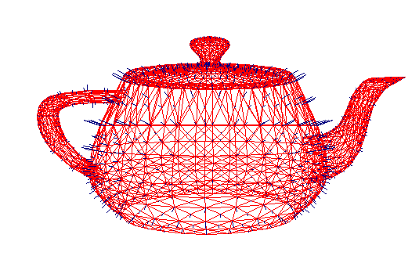
Vertex Normals
vertex normals may be
  provided with the model
  computed from first principles
  approximated by
  averaging the normals
  of the facets that
  share the vertex

Slide 51
Gouraud Shading
most common approach
  perform Phong lighting at the vertices
  linearly interpolate the resulting colors over faces
    along edges
    along scanlines
edge: mix of c₁, c₂
C₁
does this eliminate the facets?
C₃
C₂
interior: mix of c1, c2, c3
edge: mix of c1, c3

Slide 52
Gouraud Shading Artifacts
often appears dull, chalky
lacks accurate specular component
  if included, will be averaged over entire polygon
C₁
C₁
C₃
C₃
C₂
C₂
this vertex shading spread
over too much area
this interior shading missed!

Slide 53
Gouraud Shading Artifacts
Mach bands
  eye enhances discontinuity in first derivative
  very disturbing, especially for highlights

Slide 54
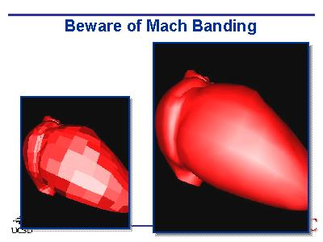
Gouraud Shading Artifacts
Mach bands
C₁
C₄
C₃
C₂
Discontinuity in rate
of color change
occurs here

Slide 55
Gouraud Shading Artifacts
perspective transformations
  affine combinations only invariant under affine, not under perspective transformations
  thus, perspective projection alters the linear interpolation!
Image
plane
Z – into the scene

Slide 56
Gouraud Shading Artifacts
perspective transformation problem
  colors slightly “swim” on the surface as objects move relative to the camera
  usually ignored since often only small difference
    usually smaller than changes from lighting variations
  to do it right
    either shading in object space
    or correction for perspective foreshortening
    expensive – thus hardly ever done for colors

Slide 57
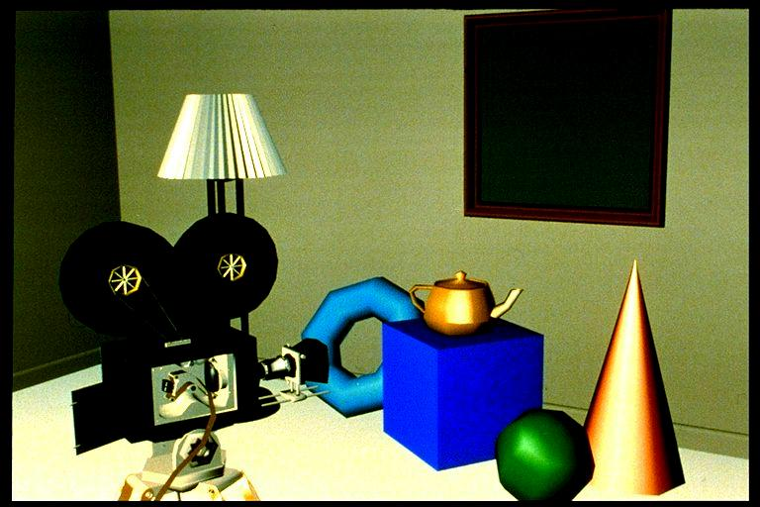
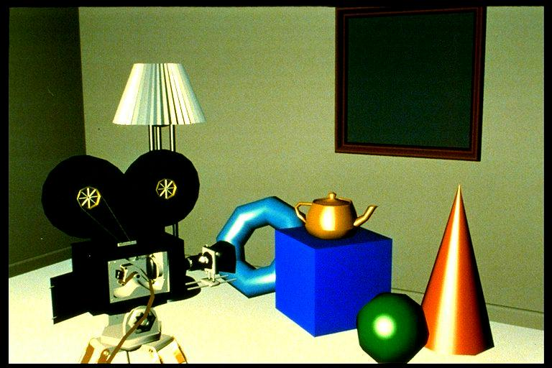
Phong Shading
linearly interpolating surface normal across the facet, applying Phong lighting model at every pixel
  same input as Gouraud shading
  pro: much smoother results
  con: considerably more expensive
not the same as Phong lighting
  common confusion
  Phong lighting: empirical model to calculate illumination at a point on a surface

Slide 58
Phong Shading
linearly interpolate the vertex normals
  compute lighting equations at each pixel
  can use specular component
N₁
remember: normals used in
diffuse and specular terms
discontinuity in normal’s rate of
change harder to detect
N₄
N₃
N₂

Slide 59
Phong Shading Difficulties
more computationally expensive
  per-pixel vector normalization and lighting computation!
  floating point operations required
  straightforward with shaders
lighting after perspective projection
  messes up the angles between vectors
  have to keep eye-space vectors around

Slide 60
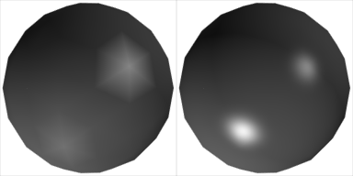
Shading Artifacts: Silhouettes
polygonal silhouettes remain
Gouraud Phong

Slide 61
Shading Artifacts: Orientation
interpolation dependent on polygon orientation
  view dependence!
A
Rotate -90º
and color
same point
B
C
i
B
D
A
D
C
Interpolate between
AB and AD
Interpolate between
CD and AD

Slide 62
Shading Artifacts: Shared Vertices
vertex B shared by two rectangles on the right, but not by the one on the left
D
C
H
first portion of the scanline
is interpolated between DE and AC
second portion of the scanline
is interpolated between BC and GH
a large discontinuity could arise
B
G
E
F
A

Slide 63
Shading Models Summary
flat shading
  compute Phong lighting once for entire polygon
Gouraud shading
  compute Phong lighting at the vertices and interpolate lighting values across polygon
Phong shading
  compute averaged vertex normals
  interpolate normals across polygon and perform Phong lighting across polygon

Slide 64
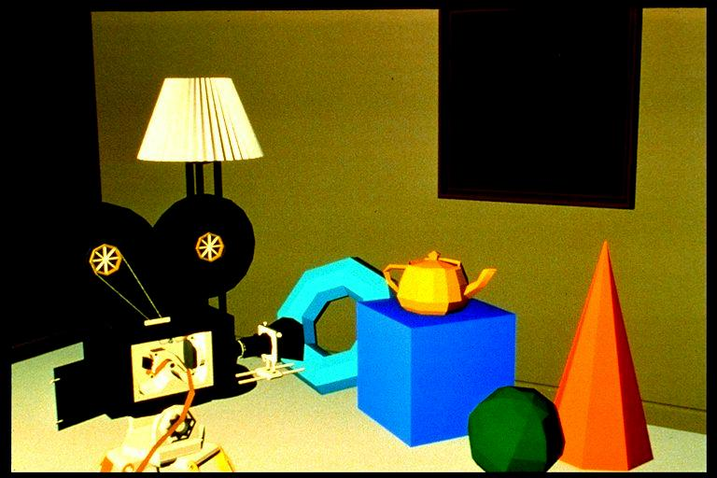
Shutterbug: Flat Shading

Slide 65
Shutterbug: Gouraud Shading

Slide 66
Shutterbug: Phong Shading

Slide 67
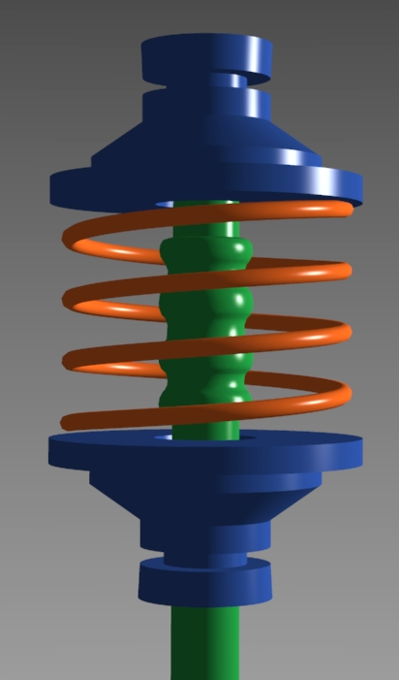
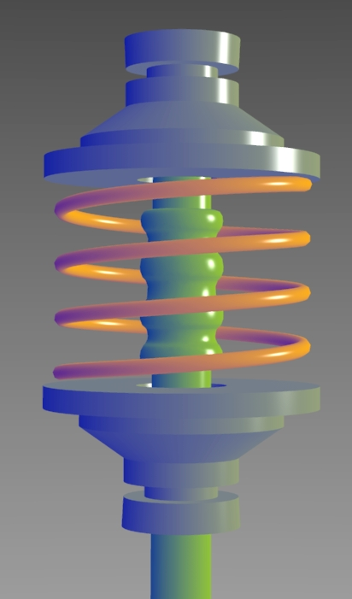
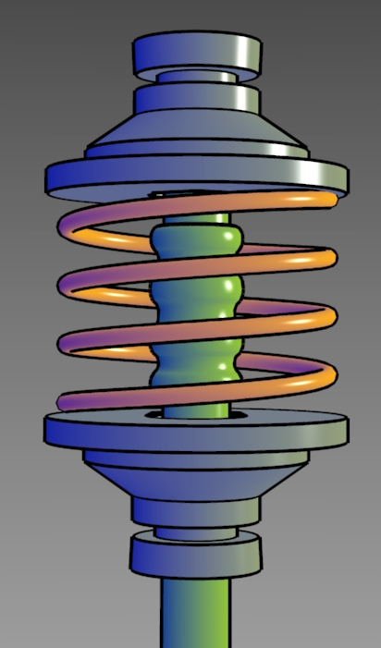
Non-Photorealistic Shading
cool-to-warm shading
http://www.cs.utah.edu/~gooch/SIG98/paper/drawing.html

Slide 68
Non-Photorealistic Shading
draw silhouettes: if , e=edge-eye vector
draw creases: if
http://www.cs.utah.edu/~gooch/SIG98/paper/drawing.html

